Slide 1
The Result of Bancor Protocol Analysis
Kenny, Sep 19th

Slide 2
Bancor is flawed
The problem of “Double Coincidence of Wants” Bancor wants to solve might not exist in real world. Even assuming this problem does exist, Bancor protocol fails to ensure its superiority compared with normal market.
The price of smart token, i.e. currency in Bancor protocol could fluctuate significantly, especially when customers generate close valuations of smart token, which might generate destructive effect on market.
Bancor protocol cannot fully process multiple transaction orders that are launched simultaneously, especially when the market size is small.
1/23

Slide 3
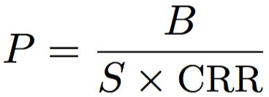
Quick Review of Bancor Protocol
What Bancor protocol actually does is to take advantage of price fluctuation to ensure the stability of reserve balance – more specifically, the stability of reserve balance’s ratio to all reserve.
E.g.
People buy Smart Tokens →
Price of Smart Tokens grows, balance of Reserve Tokens accumulates with a constant ratio →
Normally, people hesitate to buy while eager to sell →
Price of Smart Tokens decreases, balance of Reserve Tokens decreases
Ditto for sell Smart Tokens.
2/23
Notes:
Imagine there is a market with initial reserve balance, when the reserve balance accumulates (people buy smart tokens consuming reserve tokens), the price of smart tokens will also go high. Therefore, people will hesitate to buy smart tokens since price might exceed their valuation, while eager to sell smart tokens, which decreases the current reserve balance and turns it back to initial amount. Ditto for situation when the reserve balance goes low.

Slide 4
Flawed Design of Bancor Protocol
One thoughtlessness stems from the frequent price fluctuation advo- cated by Bancor protocol, which might obstruct transactions in the market.
The second flaw of Bancor protocol is that it neglects the potential abnormal marketing behaviors of customers, which might bleed market’s reserve.
Bancor protocol aims to solve “Double Coincidence of Wants” problem, which actually might not be a problem in real-world market as no previous study evidence this problem’s existence.
3/23
Notes:
even assuming the “Double Coincidence of Wants” does exist, it is unsubstantiated to say it will cause damage to market order and customers’ benefits as Bancor does not show its superiority compared with normal market laws by solid experimental results.

Slide 5
Simulating Details

Slide 6
4/23
Notes:
In synchronize step, the simulator will tell all customers the price of smart token in the current time step.

Slide 7
Classic Market Rules
5/23
Notes:
Blue plus red cancel
Red fail

Slide 8
3 stipulations in our simulating:
One time one order: for simplicity, we set that one customer at one certain time slot, can only launch one order in the market.
Gaussian-like distributed number of customers: the number of customers approaching market is Gaussian-like distributed with their valuations of commodities’ price (smart tokens in Bancor Market).
All-in and Half-in: two policies to determine the transaction value of orders. All-in is customers use all of their smart tokens or reserve tokens to sell or to buy. Half-in is customers leverage half of their assets to make a deal.
6/23
Notes:
The reason why we implement these two policies I will show you later in experiment’s section.
Results show that these two policies actually could lead really different results in classic market

Slide 9
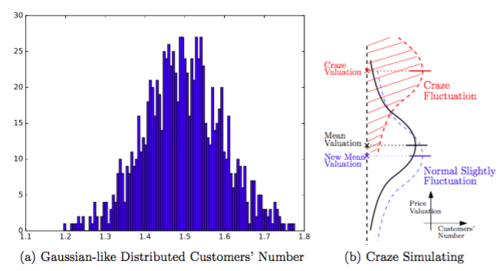
^{Gaussian Distribution &} ^{Market Craze Simulating:}
7/23

Slide 10
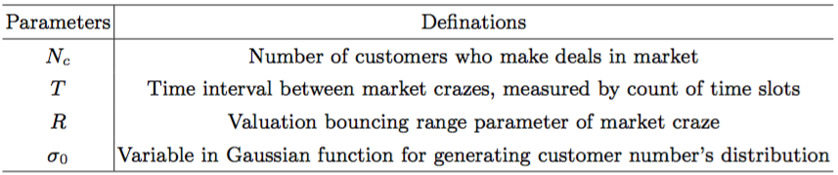
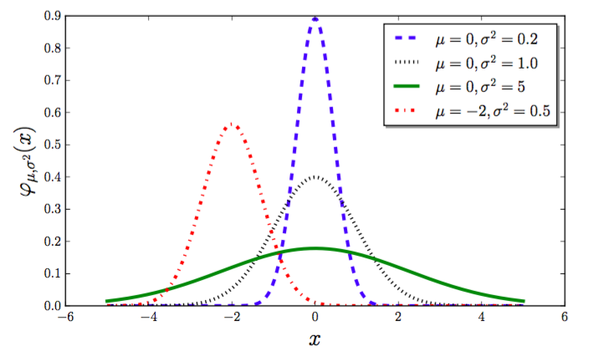
Parameters for Simulating Experiments :
The curve becomes smoother, i.e., has lower steepness with the growth of sigma; while in contrast, the peak of Gaussian curve is steeper when sigma being smaller.
8/23

Slide 11
Analysis of Experimental Result

Slide 12
Indexes for Measuring Market Performance:
Price-oriented Indexes: Under most circumstances, a healthy market is supposed to possess currency with considerably stable price.
Price Slipping Ratio: The ratio of the number of time slots in which price drops at a certain rate to the number of all time slots.
(2) Transaction-oriented Indexes: To see whether Bancor protocol efficiently handle the problem of “Double Coincidence of Wants” and largely improve the market‘s liquidity.
Total Transactions’ Number: Launched transactions’ Number in total.
Transactions’ Cancel Ratio: Simulator requires that in every new time slot, the customer has to cancel the old transaction order if it has not been finished. Here we record the cancel ratio.
9/23
Notes:
The reason why we implement these two policies I will show you later in experiment’s section.
Results show that these two policies actually could lead really different results in classic market

Slide 13
1. Analysis Based on Price

Slide 14
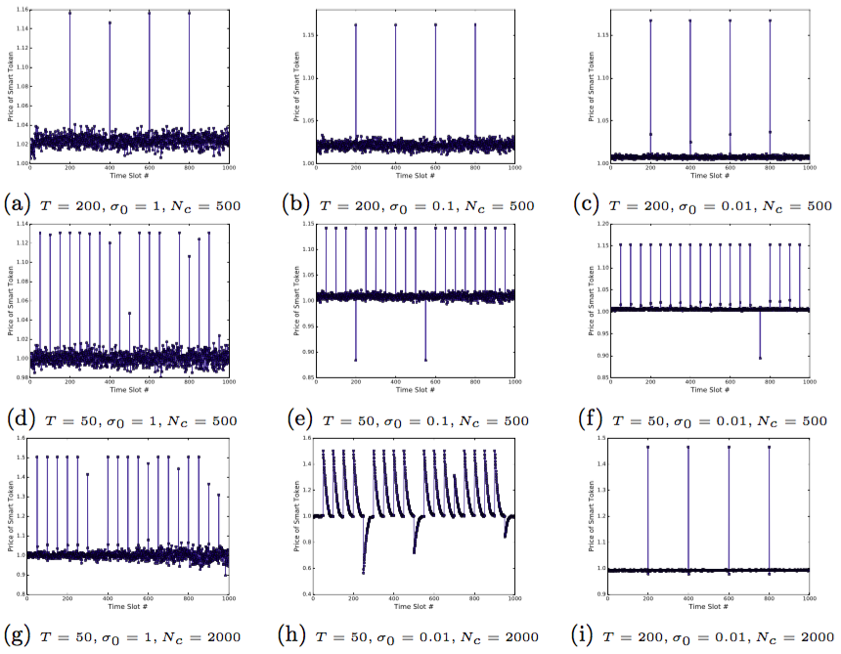
10/23
Notes:
Every blue mark represents the price of smart token in the end of the current time slot, and blue lines track the trend of price’s fluctuation.
Figure 5 represents several price fluctuating examples under different parameter initializations. By which, we can view that though market craze merges which makes the price of smart token changes fiercely, the Bancor market actually is able to adjust the price to a relatively stable state.
And by comparing subfigures in Figure 5, with
the decrease of σ and the increase of Nc, the price of smart token could be more stable.

Slide 15
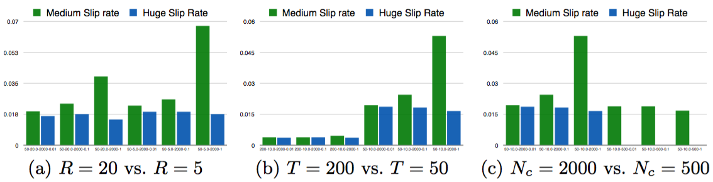
medium slip: 5%, huge slip: 20%
When market crazes emerge considerably frequently and the market owns a large size, the price slipping ratio can be quite high, e.g. almost 7%, which means the price can actually fluctuate quite significantly in Bancor market. This might lead many negative effects.
11/23
Notes:
This figure shows the price slipping ratio in 1000 time slots with different parameters settings. The labels on x-axis in the figure means the specific parameters pair, which is organized as T-R-Nc-σ0; the value on y-axis reflects the splitting ratio.

Slide 16
2. Analysis Based on Transaction

Slide 17
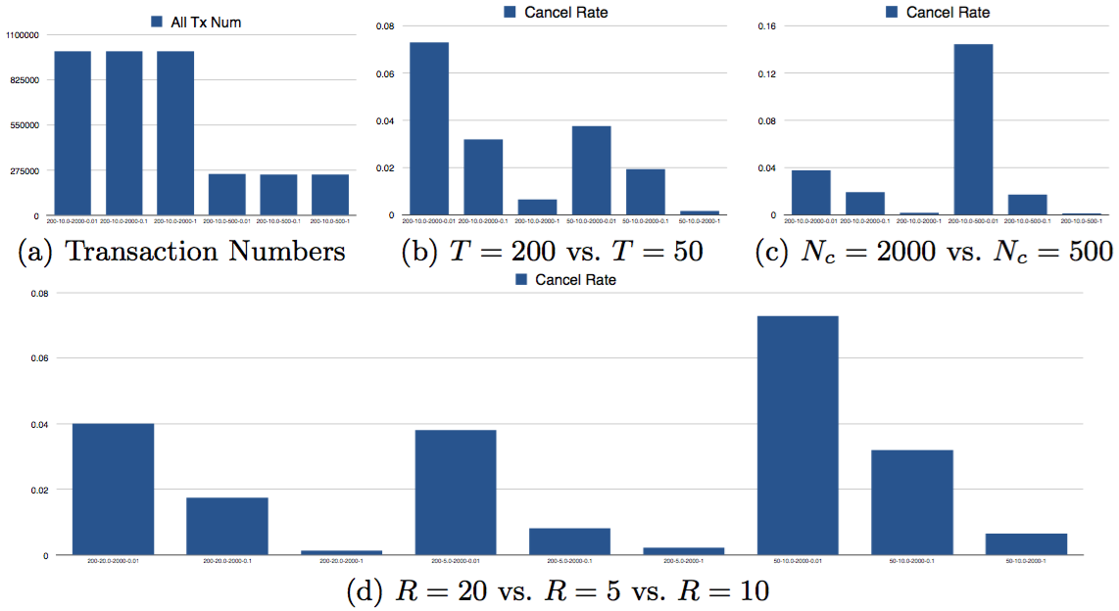
All-in Policy, Bancor Market
12/23
Notes:
By these plots in Figure 7, we learn that with the small Nc, i.e., small market size which actually is the current status of most of virtual current markets, and small σ0, i.e., the closer valuation between customers, the failure transaction orders can even take over more than 10% in Bancor market, which is actually intolerable in real world.

Slide 18
By plots above, we learn that with the small Nc, i.e., small market size which actually represents the current status of most virtual current markets, and small σ0, i.e., the closer valuation between customers, the failure transaction orders can even take over more than 10% in Bancor market, which is actually intolerable in real world.
13/23

Slide 19
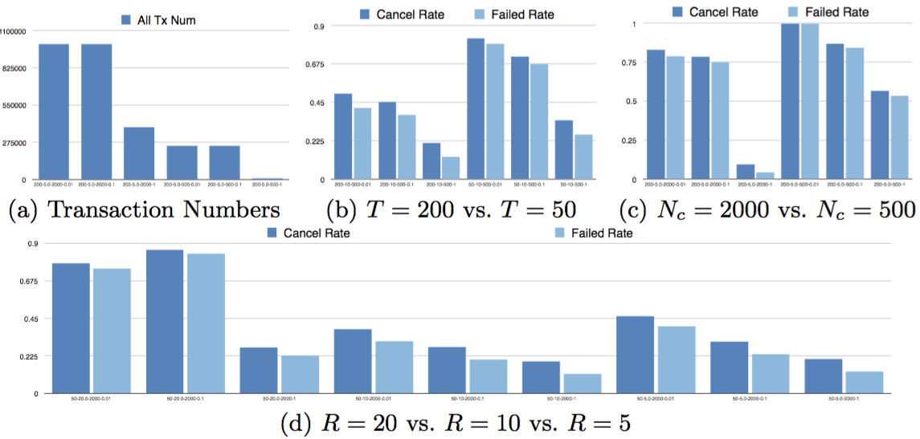
All-in Policy, Classic Market
14/23
Notes:
The low total Tx number and high cancel rate in Classic Market This is because under all-in policy in classic market, some customers quickly run out their assets as they generate low valuation to sell and generate high valuation to buy with all they own.

Slide 20
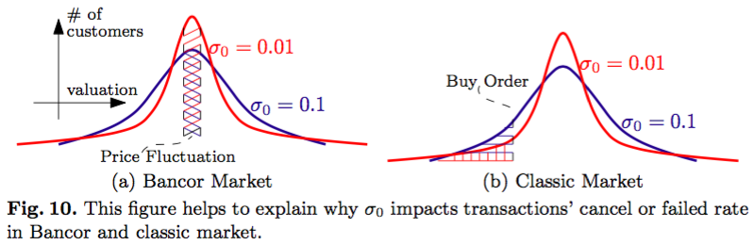
Lower the sigma is, (closer prices of valuations customers make)
higher the canceled transaction ratio is in Bancor Market;
while lower the canceled transaction ration is in Classic Market.
15/23
Notes:
when price of smart token fluctuates slightly, when σ0 is small, e.g., σ0 = 0.01, the number of influenced customers is larger than case when σ0 is large, e.g., σ0 = 0.1 – red dash shadowed area is larger than blue shadowed area in Figure 10(a). Hence, much more trans- action might be failed when σ0 is smaller in Bancor market.
Similarly in classic market, presented by Figure 10(b), when a buy order, which purchase smart tokens with lower price than its valuation comes, the the number of customers who are qualified to satisfy this buy order is smaller when σ0 = 0.01 than case when when σ0 = 0.1 – red dash shadowed area is smaller than blue shadowed area in Figure 10(b). Thus, the cancel or failed rate will be raised when σ0 is small.

Slide 21
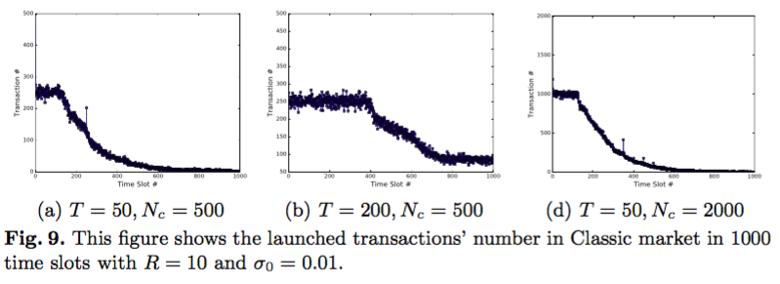
16/23
Notes:
Back to the figures about cancel ratio comparing.
The low total Tx number and high cancel rate in Classic Market This is because under all-in policy in classic market, some customers quickly run out their assets as they generate low valuation to sell and generate high valuation to buy with all they own.

Slide 22
By high transaction cancel and failed rates in above figures, where many parameter settings lead failed rate over 50%, we can conclude that under all-in policy, the “Double Coincidence of Wants” problem does exist and could bring disastrous effect on market’s efficiency.
But how about situation under half-in policies?
17/23

Slide 23
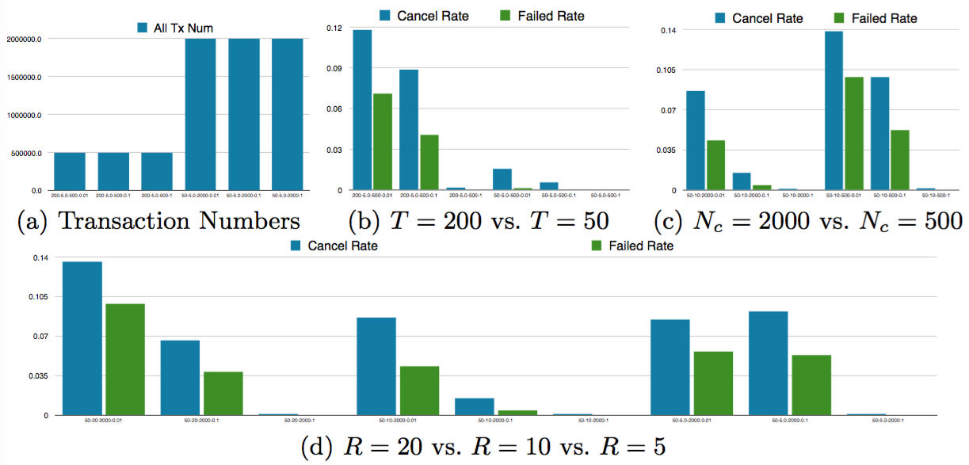
Half-in Policy, Classic Market
18/23

Slide 24
Under half-in policy, we can see that the largest failed ratio does not exceed 10%, which indicates the “Double Coincidence of Wants” might no longer be a problem in classic market.
19/23

Slide 25
Tx based: Bancor Market vs. Classic Market
The market craze actually positively accelerates the processing of transaction orders both for Bancor and classic market.
The increase of market size helps Bancor market and classic market dealing with transaction orders much more smoothly.
Under all-in policy, Bancor protocol does solve the the problem of “Double Coincidence of Wants”; while under half-in policy, the existence of that problem is uncertain and sometimes classic market performs better than Bancor market.
20/23
Notes:
By comparing the transaction-oriented performance between Bancor market and classic market, we conclude several properties as below:

Slide 26
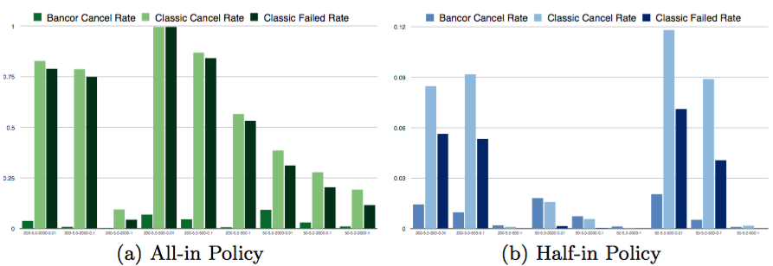
21/23

Slide 27
Bancor is flawed
The problem of “Double Coincidence of Wants” Bancor wants to solve might not exist in real world. Even assuming this problem does exist, Bancor protocol fails to ensure its superiority compared with normal market.
The price of smart token, i.e. currency in Bancor protocol could fluctuate significantly, especially when customers generate close valuations of smart token, which might generate destructive effect on market.
Bancor protocol cannot fully process multiple transaction orders launched simultaneously, especially when market size is small.
22/23

Slide 28
Thanks!
23/23

